Slide 1
Finding The Right Bud
EDA 1 | Group 3 - 2023 Lani Lewis SMU

Slide 2
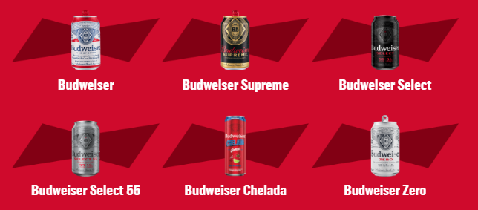
Budweiser Beer
“Budweiser is a medium-bodied, flavorful, crips American-style lager.”
5% Alcohol by Volume (ABV)
12% International Bitterness Units (IBU)
https://us.budweiser.com/
https://worldfood.guide/list/list_of_beers_in_america_by_alcohol_content_abv/

Slide 3
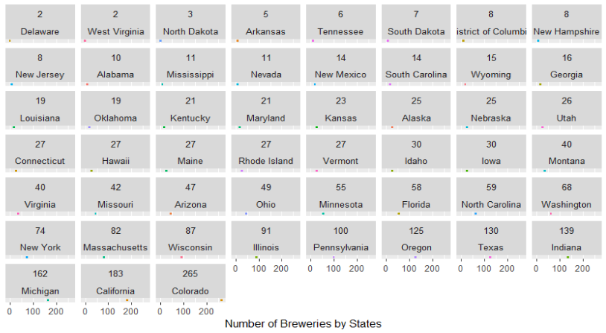
Understanding Overall State Expansion

Slide 4
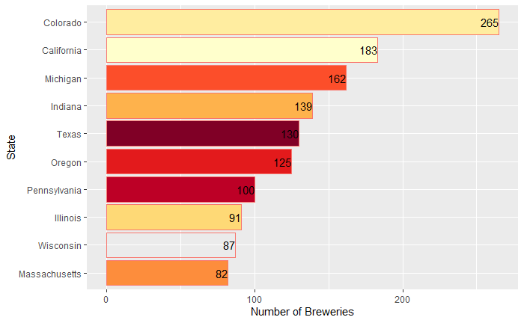
Top Ten States with the Highest Brewery Count

Slide 5
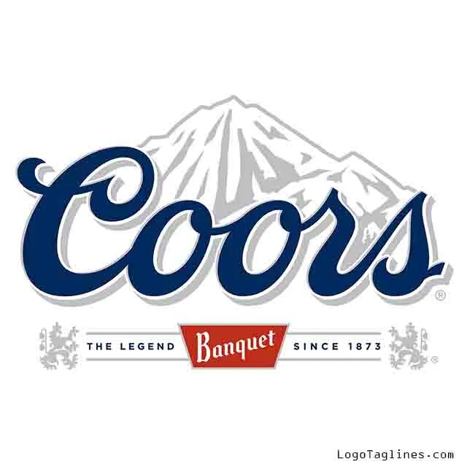
Colorado Beer History

Slide 6







Colorado Beer History

Slide 7
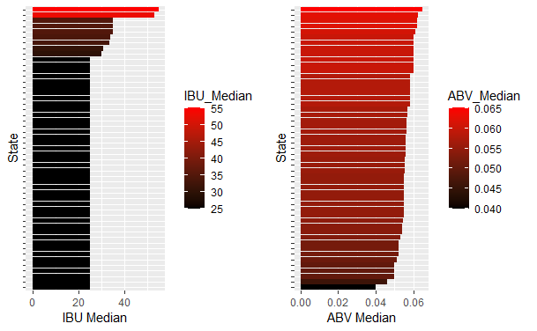
Median Values for IBU & ABV by State

Slide 8
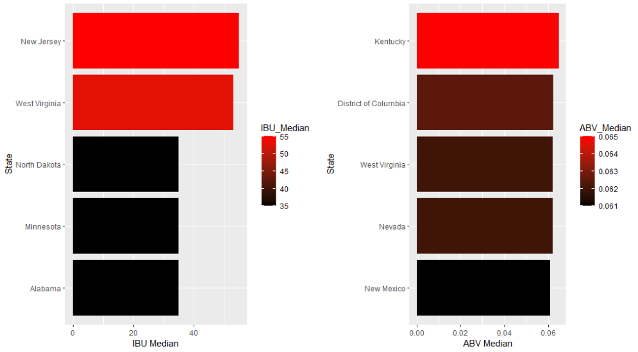
Median Values for IBU & ABV by Top Five States

Slide 9
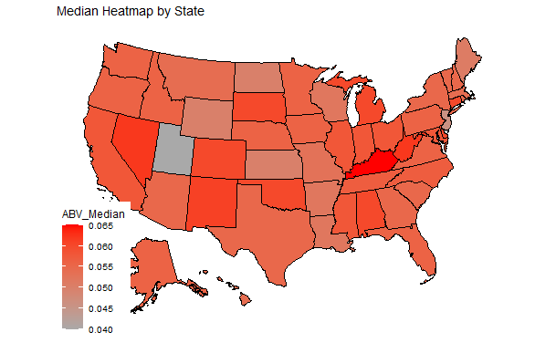
Median ABV values by State

Slide 10
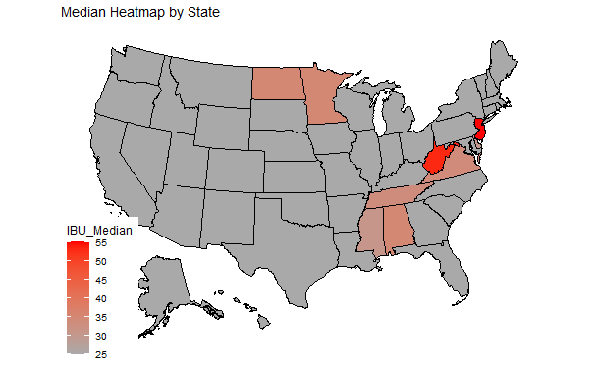
Median IBU values by State

Slide 11
Probability of Selecting a Beer Similar to Budweiser
Confusion Matrix and Statistics
class4 Ale IPA
Ale 923 78
IPA 53 480
Accuracy : 0.9146
95% CI : (0.8995, 0.9281)
No Information Rate : 0.6362
P-Value [Acc > NIR] : <2e-16
Kappa : 0.8137
Mcnemar's Test P-Value : 0.036
Sensitivity : 0.9457
Specificity : 0.8602
Pos Pred Value : 0.9221
Neg Pred Value : 0.9006
Prevalence : 0.6362
Detection Rate : 0.6017
Detection Prevalence : 0.6525
Balanced Accuracy : 0.9030
'Positive' Class : Ale
40% Chance
Style: Gose

Slide 12
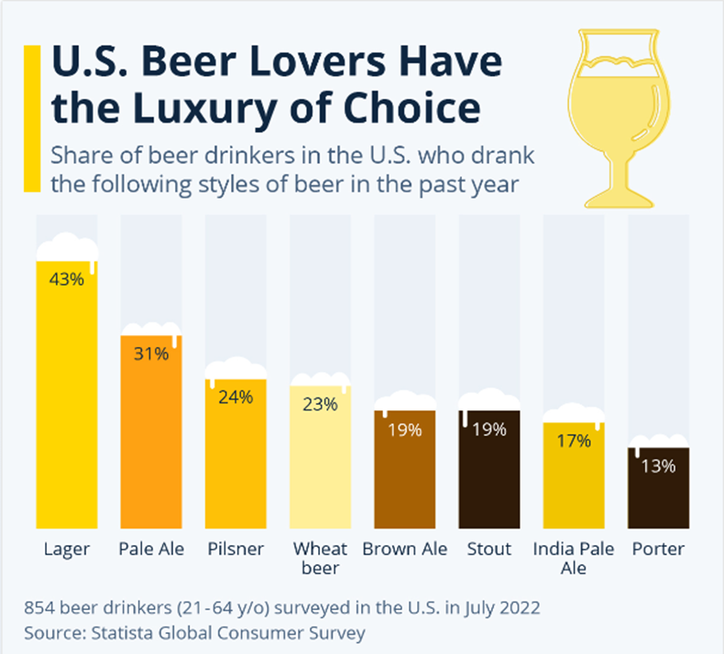
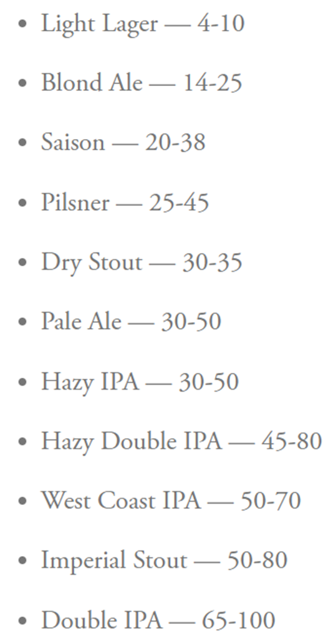
US Beer Type of Choice
IBU By Beer Type
https://www.statista.com/chart/28572/popularity-of-beer-styles-in-the-us/
https://www.firestonebeer.com/what-really-is-ibu/

Slide 13
Thank You For Your Business!
Lani Lewis - lani.k.lewis@gmail.com
Git Repo: https://github.com/lklewis83/EDA-1---2023.git

